Slide 1
Vulcan Defect Status
Jan. 04, 2016
Tao Wu, Wen Yi Gao

Slide 2
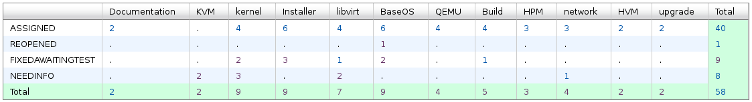
Vulcan - Open Defects
58 open defects including 9 defects in Fix-Awaiting-Test. No blocking defects for Vulcan.
5 defects new opened in the last two weeks. We solved 12 defects in the past two weeks.
Defect statistics:

Slide 3
Vulcan – High Priority Defects
Ship issue:
  Bug 126365 - Default Network Performance is less than half of line speed
    Patches are ready and under review.
    Before sending upstream, the updates need to be thoroughly tested for regression.
  Bug 134365 - SLES 12 SP1 ECKD install fails
    Under investigation.

Slide 4
Vulcan – All Defects
313 defects opened in the Vulcan Bugzilla until now

